Slide 1
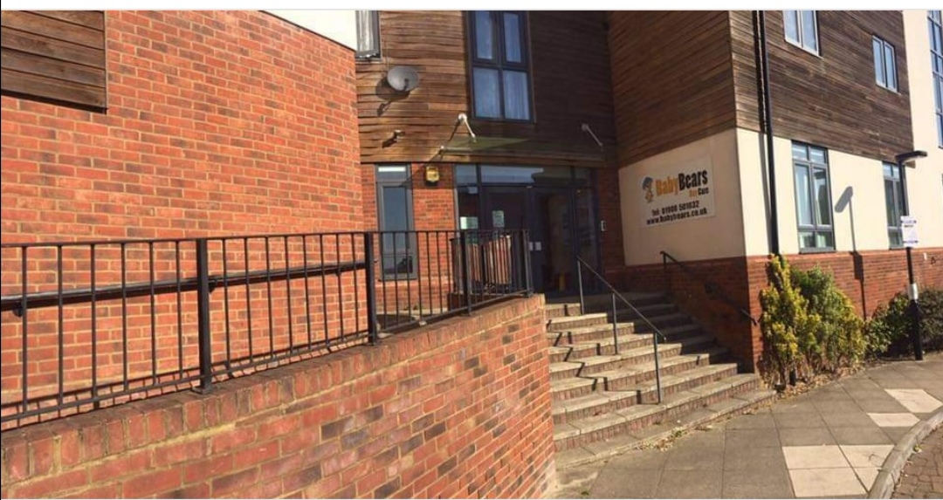
128 Dunthorne Way Grange Farm Milton Keynes MK8 0LW 01908 501032 info@babybears.co.uk

Slide 2
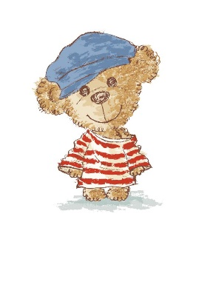
We would like to warmly welcome you to Baby Bears Day Care. We are a purpose built nursery in Grange Farm, Milton Keynes. We are open Monday to Friday 7.30am until 6pm. We pride ourselves on providing high quality childcare as well as education for children from birth to 5 years, which is appropriate to their individual needs. Baby Bears Day Care has been registered with Ofsted for 10 years and we were awarded ‘Good’ in our latest inspection in 2018.
We have 4 very spacious age appropriate rooms for all the children. 4 different garden areas, a Log Cabin outside and an onsite kitchen where all our food is prepared daily for Breakfast, Snacks, Lunch and Tea. We cater for allergies, intolerances and preferences.
We offer 3 settle sessions to begin with, the first for 1 hour where we learn from the family ( who stay for the hour) the child’s likes, dislikes, routine and what comforts them. The second session we ask parents/carers to stay for half of it then kiss and go, then the third session we ask the parents/carers to drop their child, kiss them and go so the child can settle with our amazing practitioners. If the child requires more settles then we will happily arrange these to help them. It’s a big step coming to nursery for all involved and we want everyone to be content.

Slide 3
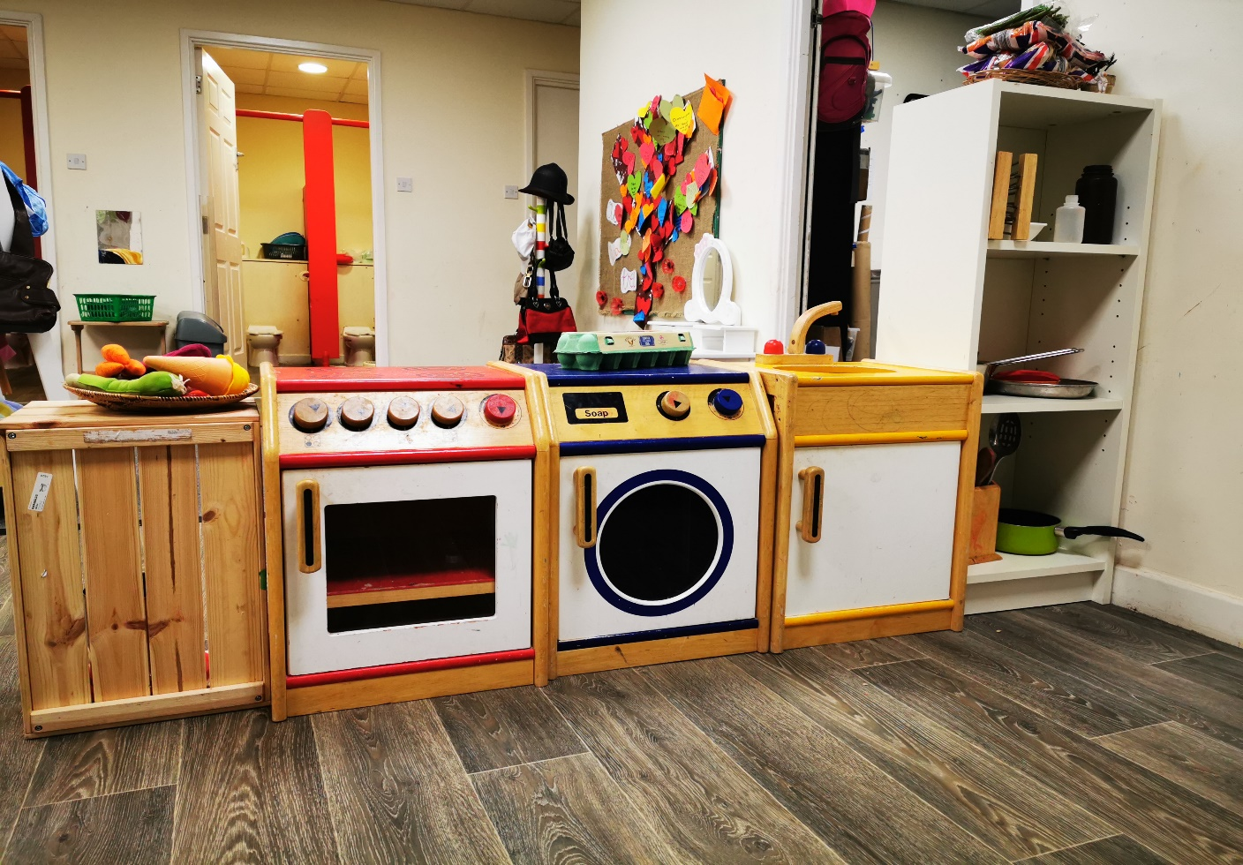
Here is our Paddington room. The age range is 3 years to 5 years. The ratio in this room is 1 adult to 8 children. Here we learn life skills, getting ready for school, becoming more independent with the guidance of our wonderful keyworkers. The children can access the toilets and hand washing facilities by themselves. We have a home corner area, a writing/drawing area, messy area, calm and comfy area, reading area and floor space to stretch our legs and imaginations. We also have children’s pegs with name and picture on for their belongings.

Slide 4
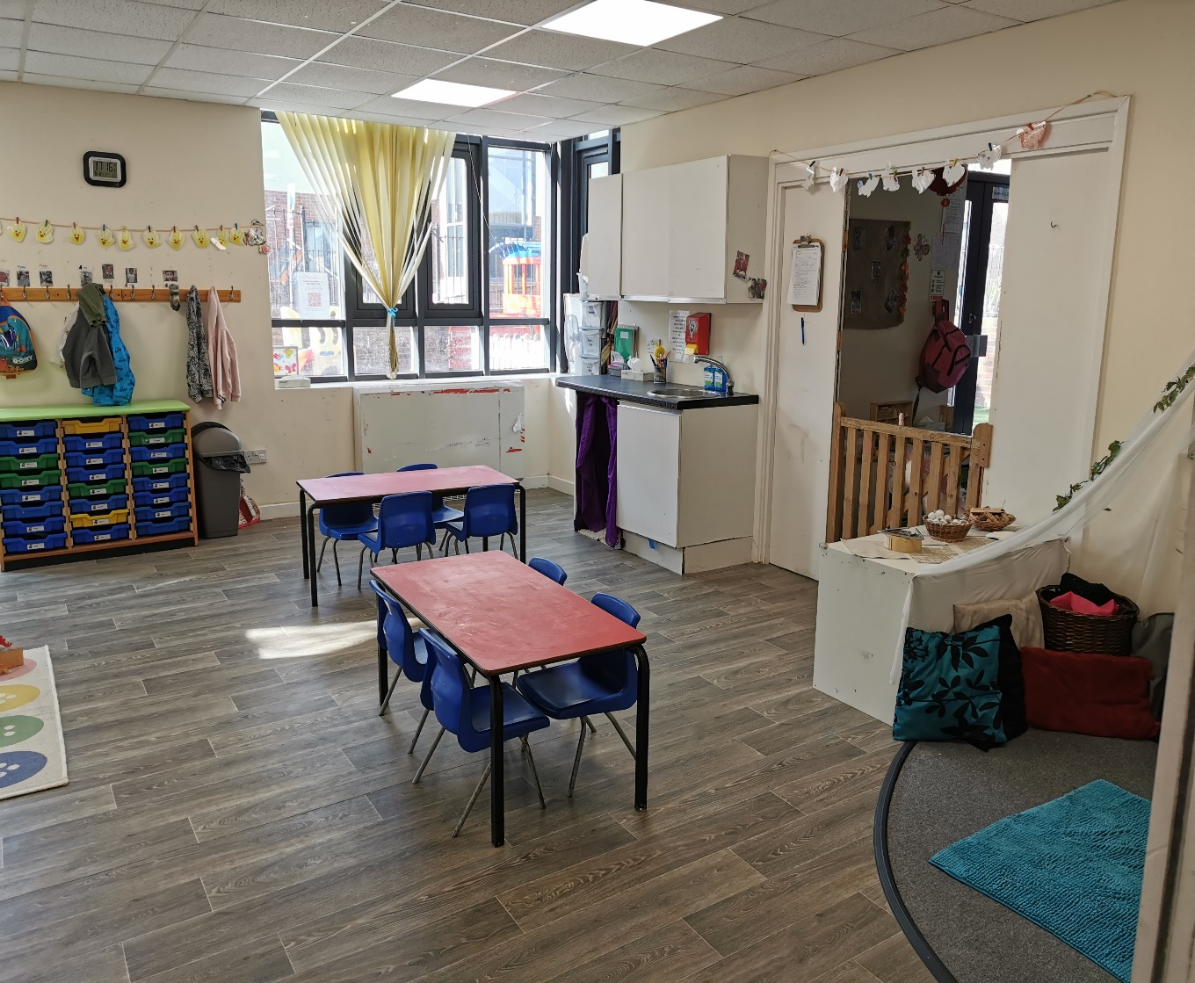
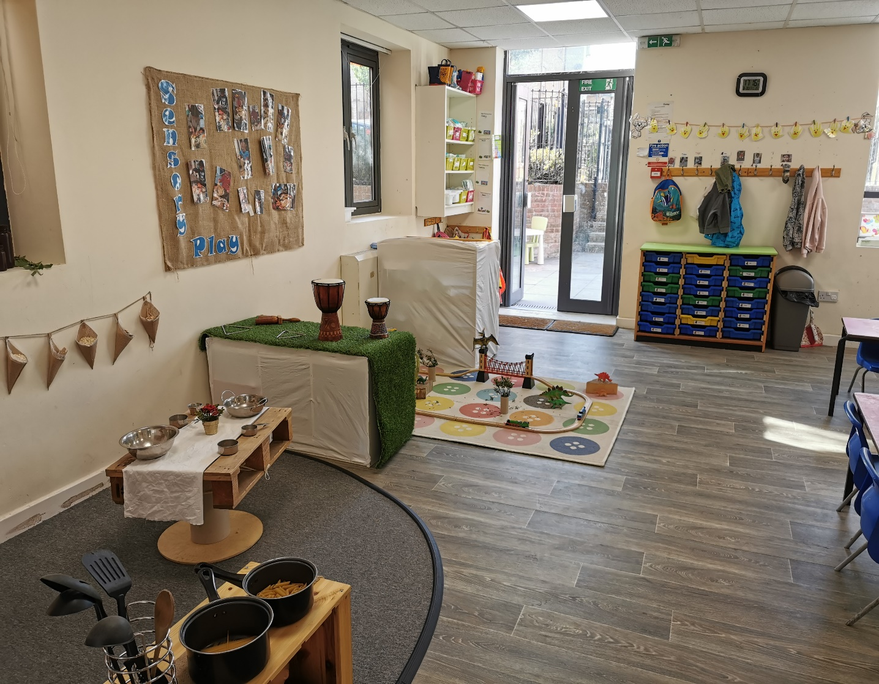
Here is our Barnaby room. The age range in here is 2 years to 3 years. The ratio in this room is 1 Adult to 4 Children. In this room we have a dedicated nappy station, each child will have their own labelled box with bits in they need, we do provide Nappies and Wipes (this is included in the price). Potty training is supported by our wonderful practitioners who will make sure your child is comfortable either on the potty or the toilet with an appropriate seat, we follow your lead, you start the training at home and we take over at nursery, this way we can work together to give your child the confidence they need to gain this life skill.

Slide 5
Barnaby’s are fortunate to have 2 rooms for their children, as our numbers are quite high for this age group, we have the luxury of free flowing between both rooms and our big gardens. They have a calm down storytelling, singing area, an imagination area where they can role play, a mark making area to use paints, chalk, pencils, playdough, sand, mud, shaving foam, different forms of food play and water play. We like to encourage children to use real life items to gain control and understanding of what things can do. There is also another allocated nappy changing area and access to our sleep room.

Slide 6
Here is our Baloo room. The age range in this room is from Birth to 2 years. The ratio is 1 Adult to 3 Children. This room is catered for children who are just learning to move their bodies in different ways like rolling over, sitting, standing, walking, holding equipment, learning to feed themselves. The dedicated practitioners in this room are trained to look after the youngest of our children and they do so with much love, care and attention.

Slide 7
Here is our dedicated sleep room, we have bunk cots for our youngest children. We also have mattresses that we lay out after lunchtime for other children who require a nap or some quiet time. All the children have a box for their own bedding, this gets washed after their sessions are over for the week. If your child has their own blanket or a special teddy to sleep with please feel free to bring it in.

Slide 8
Garden fun. Here is our main Garden and messy area, here the children of all ages can explore the outside world in all the different elements, we play in rain, sun (shade), snow, wind and sleet. We have a messy area for the children to use all of their senses. They have space to run, ride, hop, jump, balance, kick a ball, throw a bean bag, climb, scoop, dig, build, crawl, skip and relax. The Garden is secured by fencing all the way around and we have a locked gate. In the Garden is where we can watch nature, birds and bugs and where we can watch things grow.

Slide 9
Baby Garden fun. Here is our own space for the younger children to explore safely. They have a mud kitchen at their level so they can pull themselves up on it, experience messy play such as water, sand, mud, foam, paint, leaves and food play. They have the room to practice climbing, seesawing, riding, running and balancing. They also have a restful area where they can sit and have stories or songs or snack with their friends.

Slide 10
The Log Cabin is our outside classroom. This is used by all the children. They can all enjoy a range of different activities within it. We like to have snack and tea outside in the log Cabin whenever we can, it has adequate heating and lighting. There is space for safe storage of outside toys and plenty of room left to play in. We can turn it into a magical grotto for Christmas when Santa comes to visit us.

Slide 11
Thank you for requesting to have a look at our Nursery. If you require any further information or a parent pack please email – info@babybears.co.uk or call us on 01908 501032. You can follow our page on Facebook – Baby Bears Day Care Grange Farm and Instagram – Baby Bears Day Care.

